Slide 1
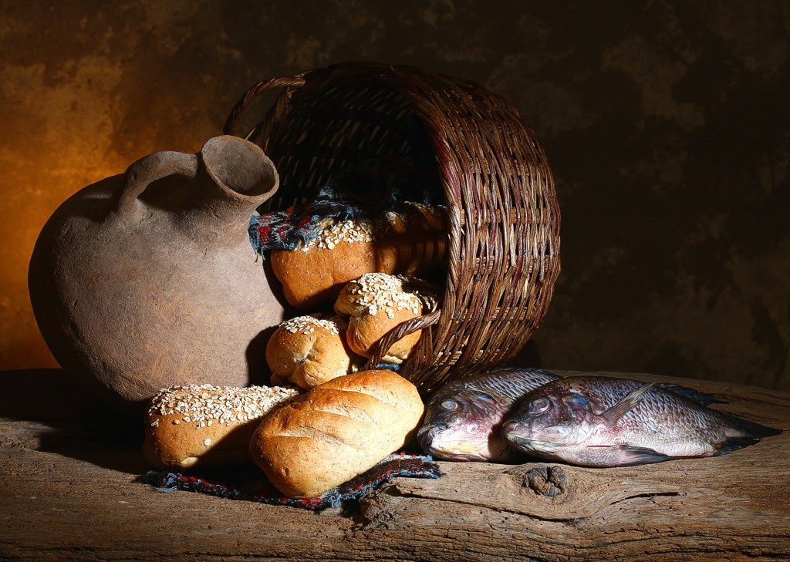
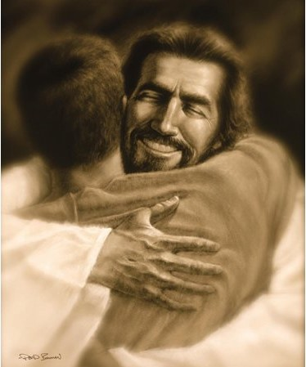
The Double-in-Five Challenge - it is a parish challenge to double the number of committed disciples of Jesus in 5 years How? P. 186

Slide 2
How to double-in-five? 1. Set goals (see examples on p. 186)
2. Break the silence (how? -pp. 188-190)
3. Offer multiple overlapping opportunities both for baptised and non-baptised to personally encounter Jesus (how? – ch. 11)
4. Expect conversions (ch. 12)
5. Intercessory prayers (ch. 12)

Slide 3
2. Break the silence of not sharing our faith and relationship with Jesus – How? a. Talk openly about the possibility of personal relationship with God b. talk about following Jesus c. Ask others (incl. church members) about their relationship with God d. Tell the great story of Jesus to others in the church. You will be surprised to realise that many people are open to hear it. p.188

Slide 4
Deliberately & persistently break silence

Slide 5
- establish a bridge of trust - then ask people to talk about their lived experience of discipleship (threshold conversations) + listen to what they have to say - and find out at what stage (which threshold) the person is in becoming an intentional disciple of Jesus

Slide 6
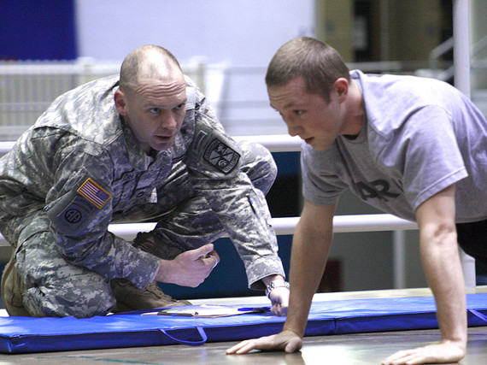
- because if you know where people have been and where they are on their faith journey we can more effectively encourage them towards intentional discipleship (see practical idea on p. 192)
This Photo by Unknown Author is licensed under CC BY-SA-NC

Slide 7
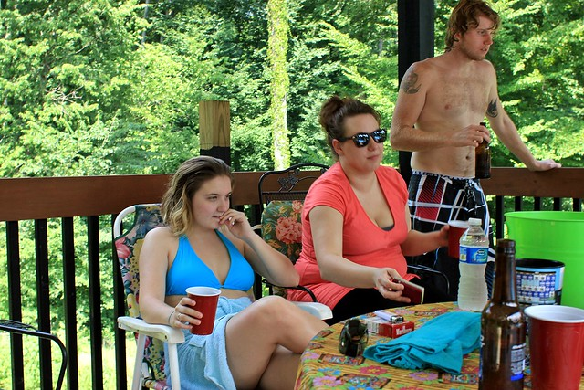
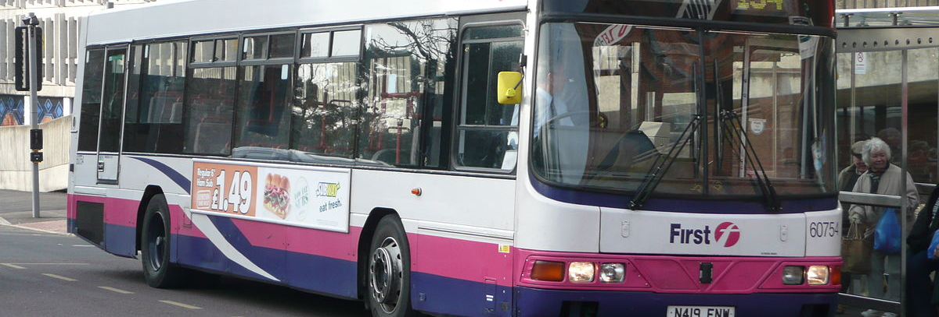
The ABCs of threshold conversations - it is an incredibly powerful tool of evangelising (which simultaneously breaks the silence and raises the central issues of what it means to be a Catholic Christian. - you can have these types of conversations even sitting on a bus or an airplane, or with family, friends and acquaintances - but a bridge of trust between you is a pre- condition for this
This Photo by Unknown Author is licensed under CC BY-ND
This Photo by Unknown Author is licensed under CC BY-SA
This Photo by Unknown Author is licensed under CC BY-NC

Slide 8
- It is a supportive, inviting, open-ended, prayerful listening witness to God’s love, compassion and forgiveness (it is not about converting people to Christianity) - in it you need to listen to more than just words; you listen also to what comes across beyond words (meaning and feelings beyond the spoken words) - it is NOT FAITH SHARING
This Photo by Unknown Author is licensed under CC BY-NC

Slide 9
- NEITHER COUNSELLING - NEITHER APOLOGETICS - NEVER JUDGMENTAL
This Photo by Unknown Author is licensed under CC BY-NC-ND

Slide 10
- But it is extremely SIMPLE In practice: Start with asking the following or similar question: Can you describe your relationship with God to this point in your life? Or Can you tell me about the story of your relationship with God so far?
This Photo by Unknown Author is licensed under CC BY

Slide 11
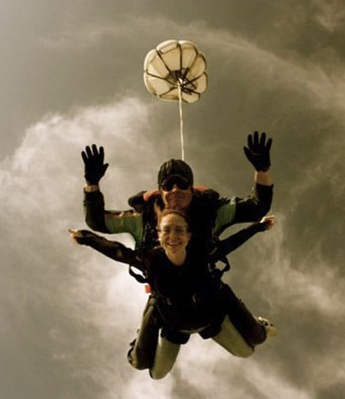
Peoples lived experiences of relationship with God can be totally out of line with their religious belonging IMPORTANT RULE: never accept a ‘label’ in the place of a life story p. 194
This Photo by Unknown Author is licensed under CC BY-SA

Slide 12
?
liberal
laity
baptized
practicing Catholic
progressive
evangelical
left
active
atheist
pro-life
confirmed
clergy
right
convert
married in the Church
conservative
fallen away Catholic
Notes:
What is FID? Pause: What other labels might you add?

Slide 13
If someone describes himself/herself as an ‘atheist’ ask the question: What do you mean by being an atheist? Or Tell me about the God that you don’t believe in? or Do you believe in any other kind of God or universal spirit? P. 195
This Photo by Unknown Author is licensed under CC BY-ND

Slide 14
If the person still describes himself/herself as an atheist, ask: Have you ever believed in God? If so, why did you stop believing in him? Or Do you ever pray? If yes, how? Or What gives meaning to your life? P. 196
This Photo by Unknown Author is licensed under CC BY-ND

Slide 15
Remember you need to have a bridge of TRUST If none is in place, foster one first p. 196

Slide 16
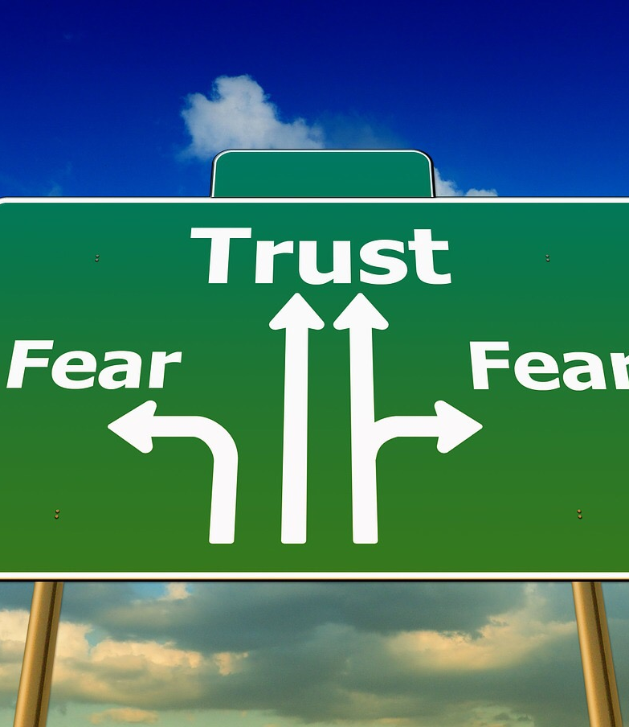
How to find out if there is trust towards religion in place? Ask: Have you had a significant exposure to religion or spirituality at some point in your life? Are you close to any religious or spiritual person? Why do you like/trust him/her? What role does God play in his/her life? How do you fell about that? Could you ever imagine believing in God? If so what would that God be like? [See a list of questions you may ask, on p. 198] P.196
This Photo by Unknown Author is licensed under CC BY-ND

Slide 17
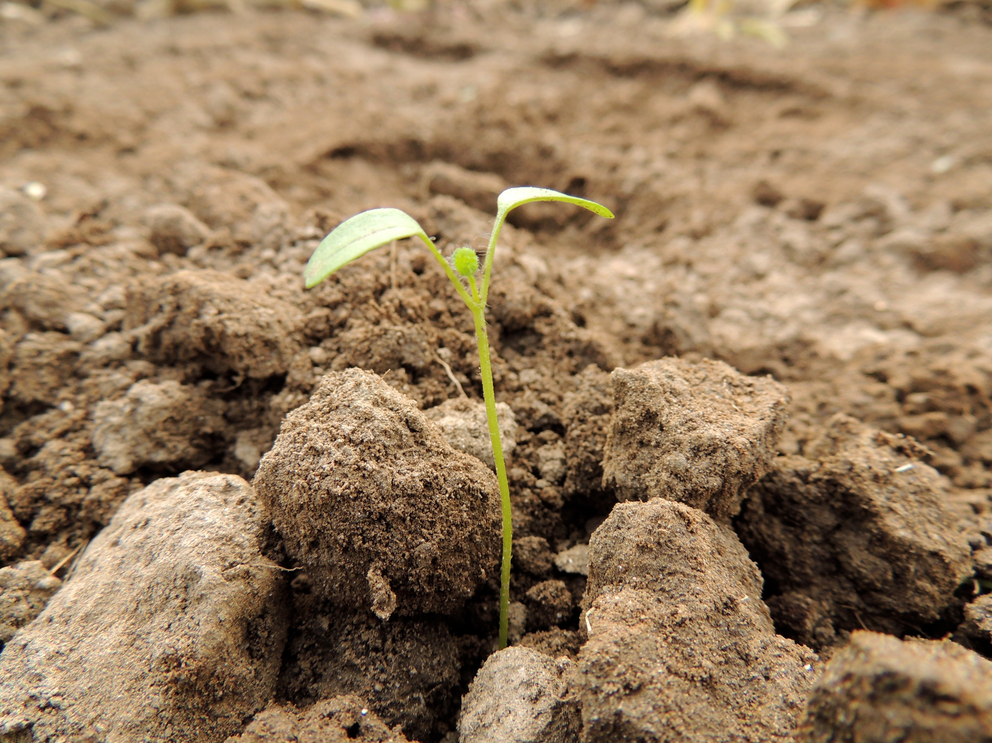
Our goal in such kind of conversations is to listen for the ‘’seeds of the Word’’ (what the Spirit has already done= preparation) and to lay bare reverently these seeds of the Word that lie hidden in your conversation partner p. 197

Slide 18
When people are asked, especially the first time, about their relationship with God, they may become open to a new perspective p. 197

Slide 19
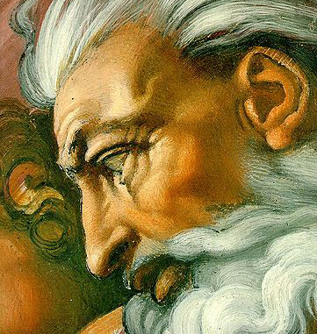
So there are 2 basic questions to ask Start with: What has your relationship with God been like to this point in your life? Finish with: If you could ask God one question that you knew he would answer right away, what would it be? See p. 198

Slide 20
When we are in conversation, we eventually have to tell the Great Story of Jesus (the kerygma) see p.199

Slide 21
what next?
Study the book.
Talk about it in your parish or ministry setting.
Reflect on:
if/how your parish or ministry deliberately allows space for spiritual journey #1
ways to be sensitive to and discern the many thresholds and complex conversion processes of those who are not yet disciples
Check out additional resources at:
http://practicalevangelization.wordpress.com/tag/resources-for-intentional-discipleship/
naming discipleship
Forming Intentional Disciples
?

